Slide 1


ATLAS Logos
ATLAS Surveillance Program logo.

Slide 2

ATLAS Surveillance Program
Pfizer ATLAS Program flyer (front).

Slide 3
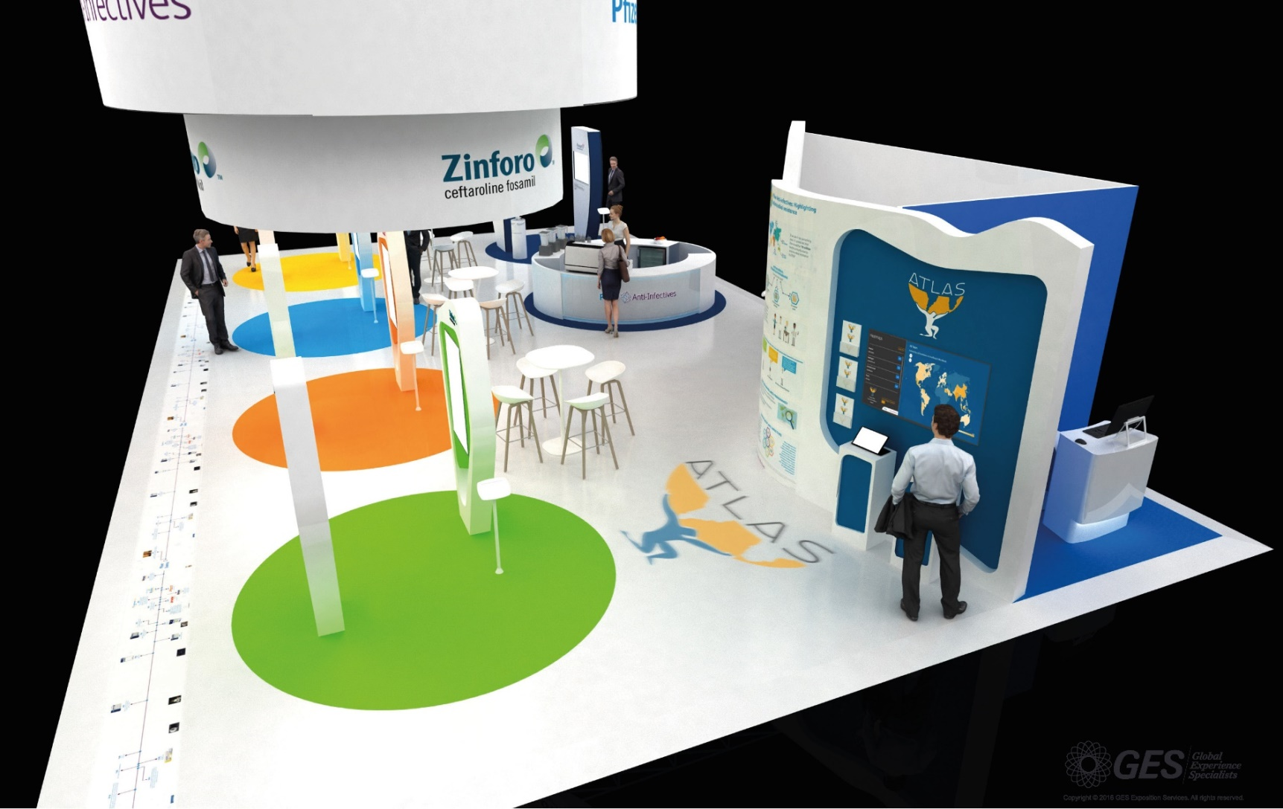
ATLAS Surveillance Program
Pfizer ATLAS Program exhibit renders.

